Slide 1

Residential Management System
Team Members:
Andrea Joyce Sequeira
Anuja Ajit Surana
Bhagyashri Chavan
Suraj Visveswaraiya
Vaidehi Sandeep Tawde

Slide 2
"Revolutionizing Residential Management: Our Mission and Objectives"
Mission
Mission Statement:“ Revolutionizing how modern communities and townships are managed.“
Elevate
Objectives: Enhanced Quality of Life: Elevate residents' living standards through efficient, accessible, and community-focused solutions.
Optimize
Operational Efficiency: Optimized residential management processes to achieve superior operational effectiveness.
Integrate
Innovative Management Solutions: Integrated advanced technical solutions like triggers, constraints, to address traditional challenges in residential management.
Build
Sustainable and Scalable Systems: Built adaptable, future-proof systems that grow and evolve with community needs.
Addressing
Addressing Core Business Problems: Tackled key issues like resource allocation inefficiency and complex billing to enhance management experiences

Slide 3
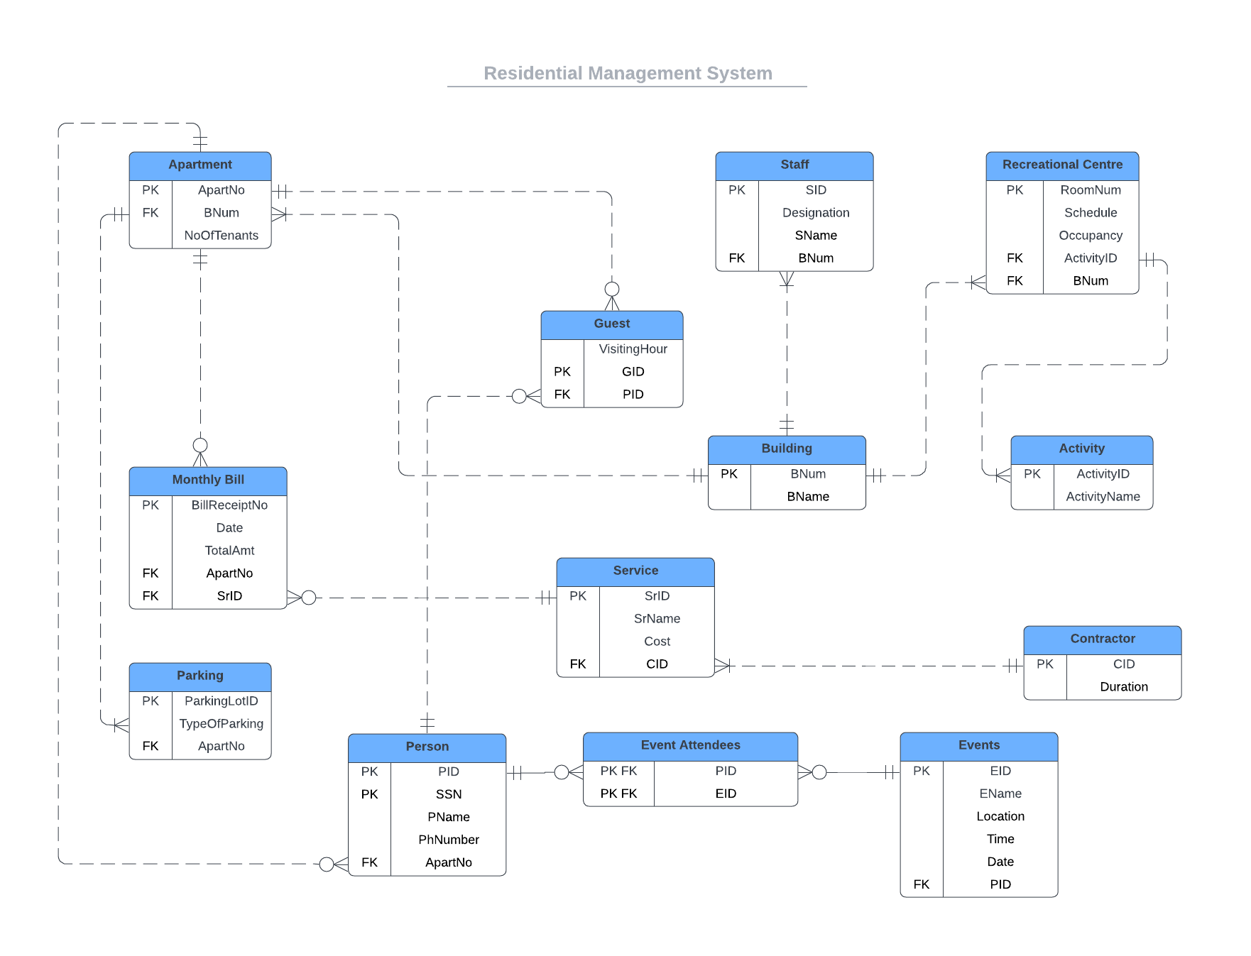
Entity Relationship Diagram

Slide 4
Strategic Decisions in Database Design
Criteria for Inclusion: Entities included based on their direct impact on residential management effectiveness. Examples: Building, Apartment, Monthly Bill - chosen for their centrality to the management process.
Building: The Core Entity: Significance: Central to the database, linking to various other entities like Apartment, Staff, and Recreational Center. Reasoning: Reflects the physical structure and is essential for managing spatial and administrative aspects.
Apartment: Residential Focus: Significance: Represents individual living units, crucial for tracking occupancy, rental details, and tenant information. Reasoning: Directly impacts resident satisfaction and operational efficiency, essential for personalizing management.
Monthly Bill: Financial Management: Significance: Key to managing financial transactions, billing cycles, and service charges. Reasoning: Central to financial health and resident satisfaction, ensuring transparency and accuracy in billing.
Additional Entities: Comprehensive Management: Entities like Recreational Center, Services, Contractors, and Person. Reasoning: Each entity included to cover all aspects of residential management comprehensively, from amenities to personnel.
Emphasis on Interconnectivity: Explanation: Highlighting the interdependence of entities for a holistic management approach. Visuals: Use of ERD diagrams to illustrate connections and flow between entities.

Slide 5

Streamlining Finances: Monthly Billing Optimization
Relationship Change in Billing:
From One-to-One to One-to-Many: Transition of the relationship between Apartment and Monthly Bill. Rationale: To accommodate multiple bills per apartment, reflecting realistic billing scenarios.
Impact on Billing Efficiency: Enhanced Efficiency: Facilitates the management of varied bills for different services in a single apartment. Real-Life Application: Eases the process of generating and tracking bills for residents and management.
Benefits to Residents and Management: For Residents: Improved clarity and tracking of their monthly expenses. For Management: Streamlined billing process, leading to reduced errors and administrative workload.

Slide 6
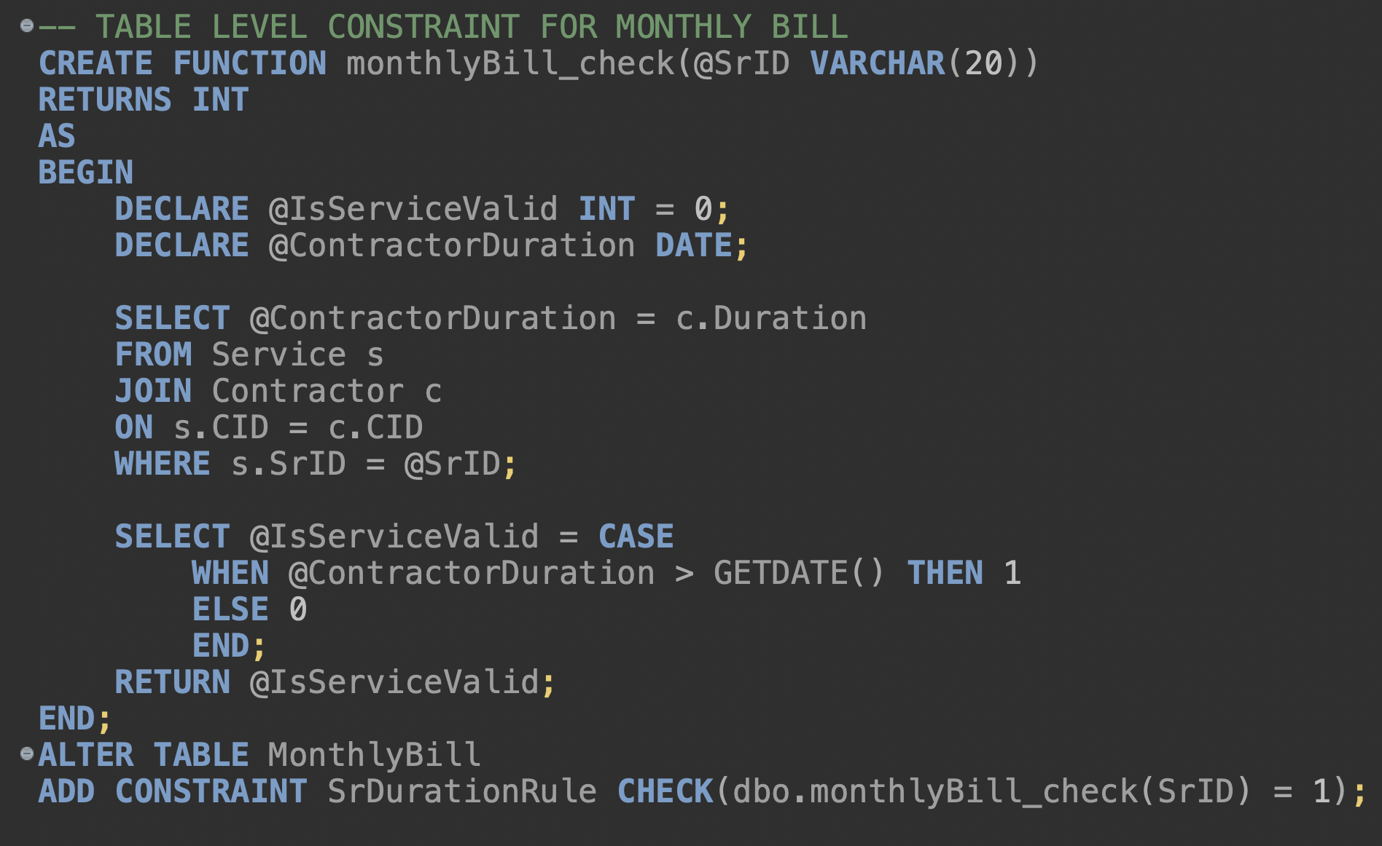
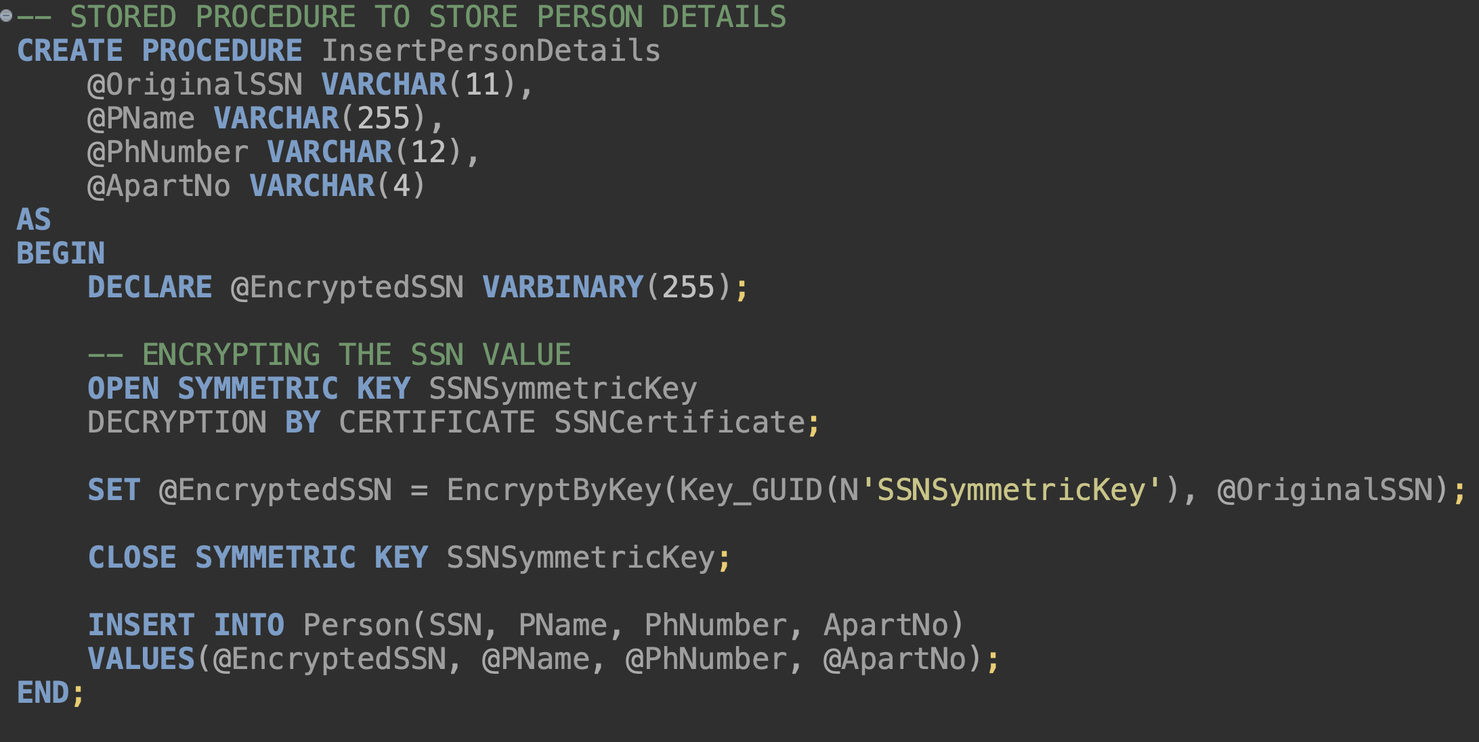
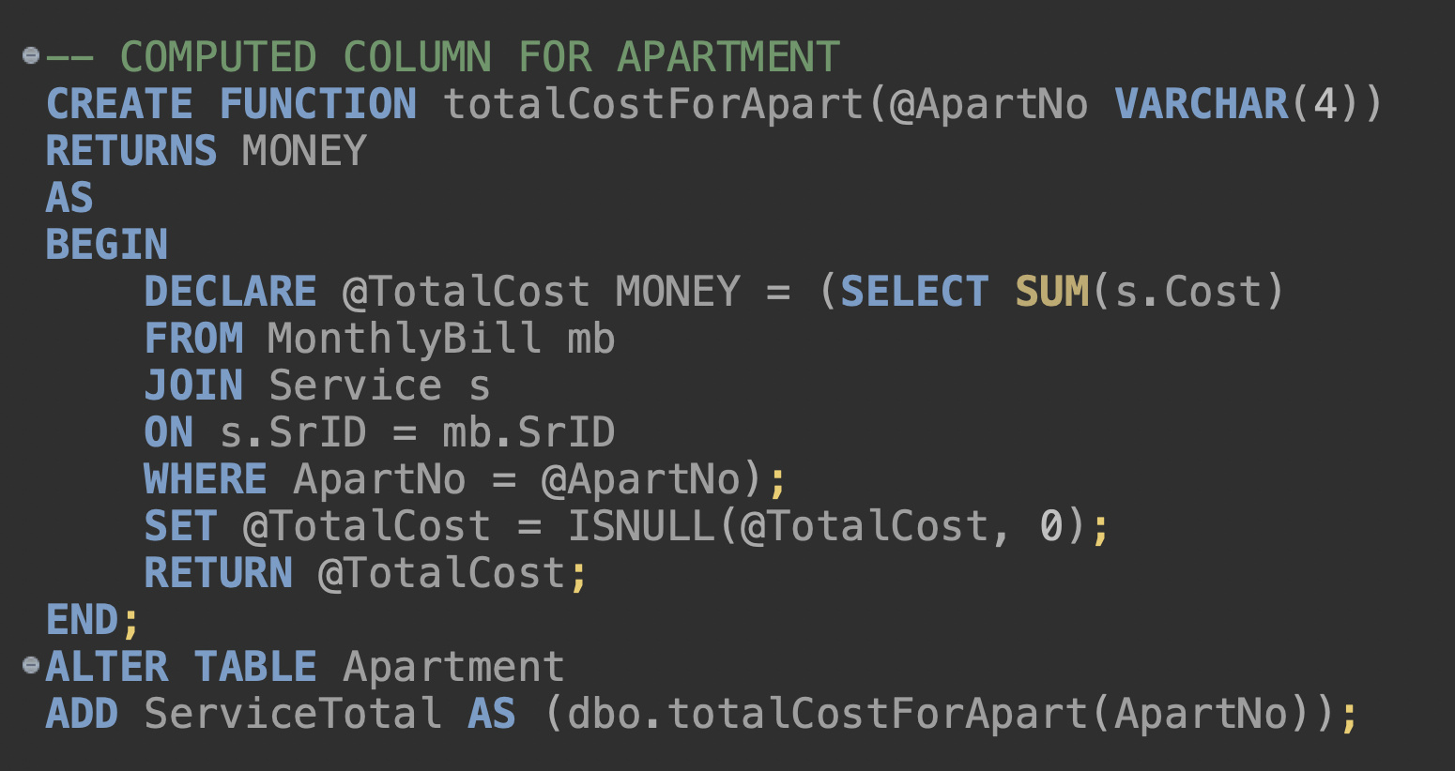
Constraint, Stored Procedure, Encryption and Computed Column

Slide 7
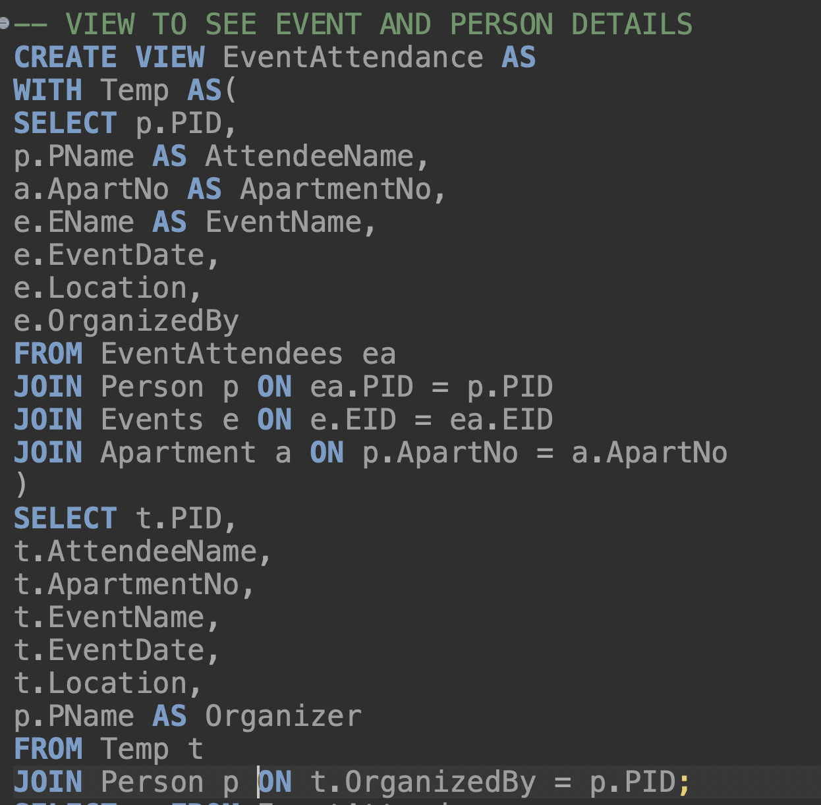
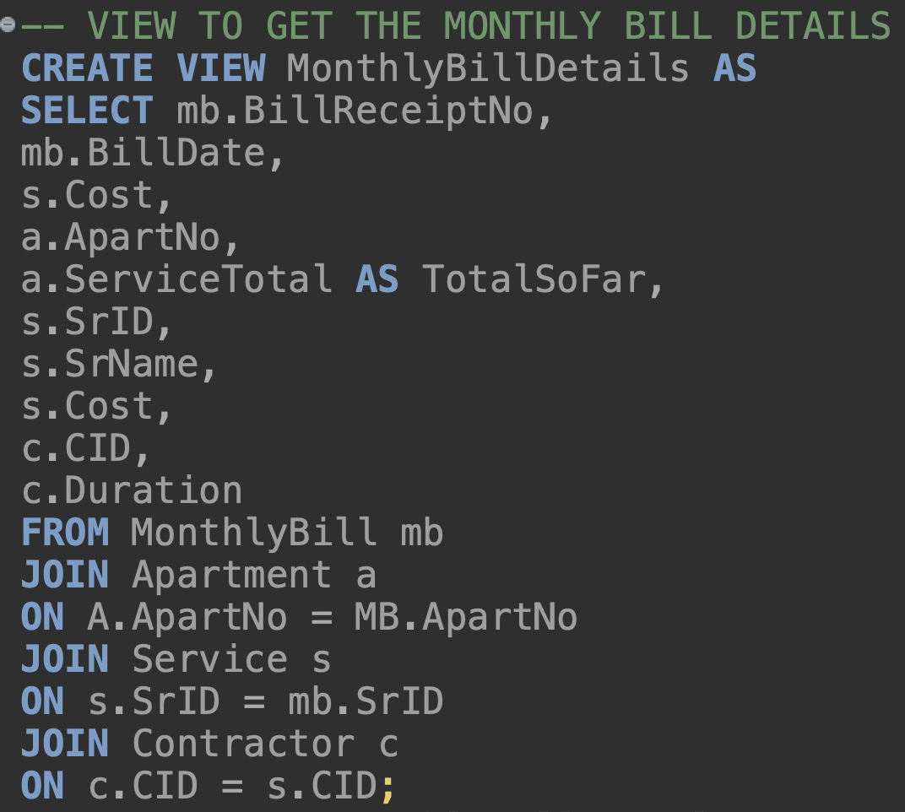
VIEWS

Slide 8
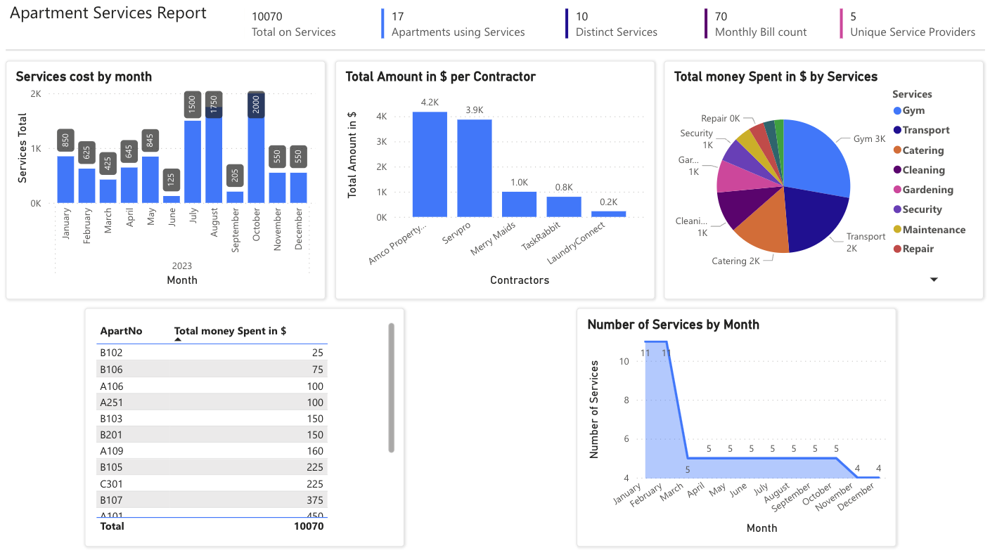
REPORT AND VISUALIZATION

Slide 9
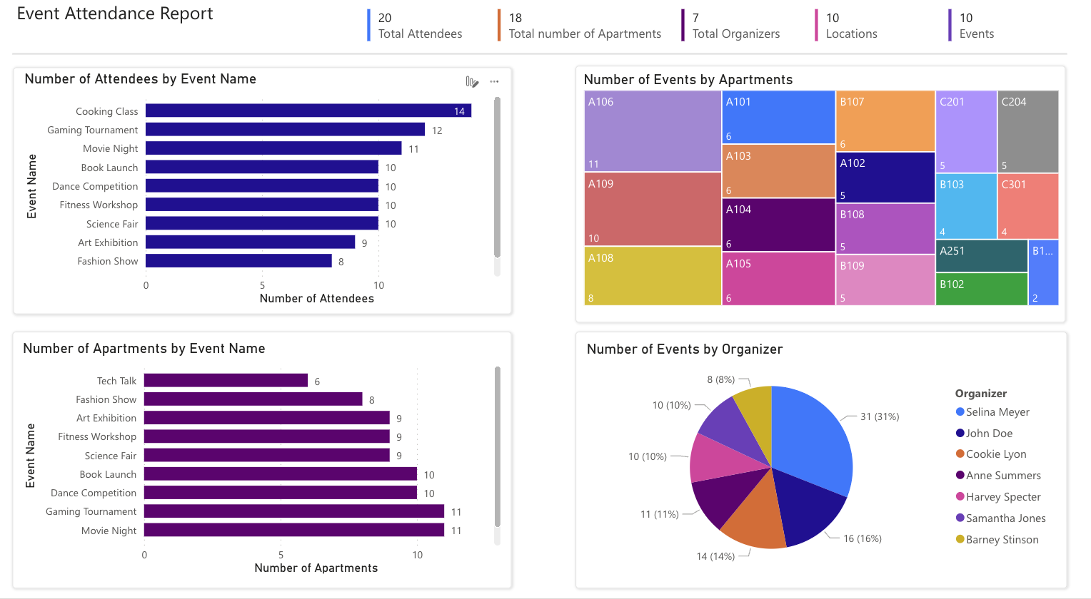
REPORT AND VISUALIZATION

Slide 10
Shoot your questions!

